Slide 1
Recursion
AI2C Tech Intro
Jul 2026

Slide 2

What is recursion?
To understand recursion, you must understand recursion
An algorithm that uses itself in its definition
“pip installs packages”
Two requirements:
A base case
A recursive step

Slide 3
Terms
Base case:
The “terminating step”
How does the recursion stop?
Recursive step:
Decreases the size of the input
Passes smaller input to a new instance of itself

Slide 4
An example
What is(are) the base case(s)?
What is(are) the recursive step(s)?
The input datatype doesn’t change
Small demo
def factorial(n: int):
if n == 1 or n == 0:
return 1
return n * factorial(n - 1)

Slide 5
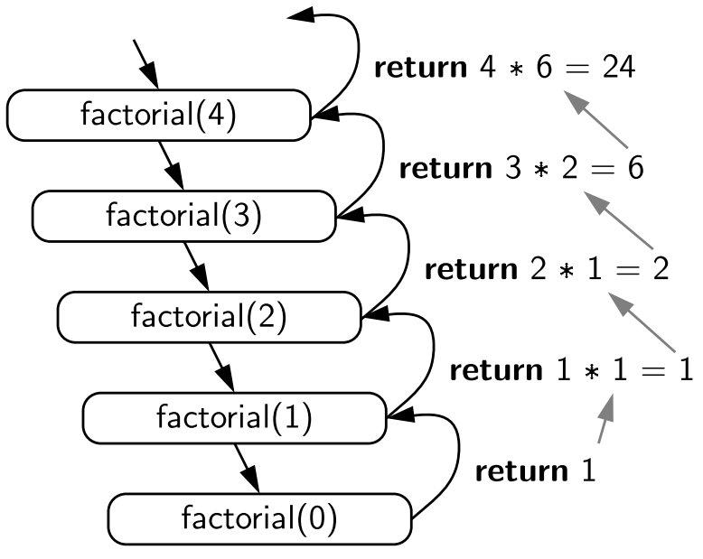
Order of Execution / Return Values

Slide 6
On Your Own
Calculate the sum of a list of numbers using recursion
What is(are) the base case(s)?
What is(are) the recursive step(s)?
(be careful about passing lists around)

Slide 7
A solution
def re_sum_one(num_list: list[int]) -> int:
if len(num_list) == 1:
return num_list.pop()
last = num_list.pop()
print(f"Calculating {num_list[:]} + {last}")
return re_sum_one(num_list[:]) + last

Slide 8
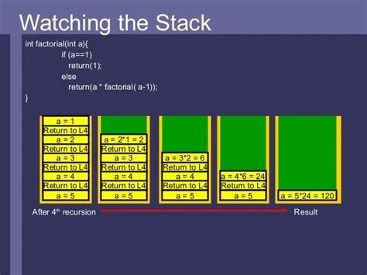
More about stacks
What bad things can happen here?
Don’t forget the base case!
Small demo

Slide 9
Multiple Recursion

Slide 10
Multiple Recursion
A function that calls itself multiple times
What is(are) the base case(s)?
What is(are) the recursive step(s)?
def fib(n: int) -> int:
if n == 0:
return 0
if n == 1:
return 1
return fib(n-1) + fib(n-2)

Slide 11
Another Example
def re_sum_half(num_list: list[int]) -> int:
if len(num_list) == 1:
return num_list[0]
half = len(num_list) // 2
return re_sum_half(num_list[:half]) +
re_sum_half(num_list[half:])

Slide 12
Other Common Problems

Slide 13
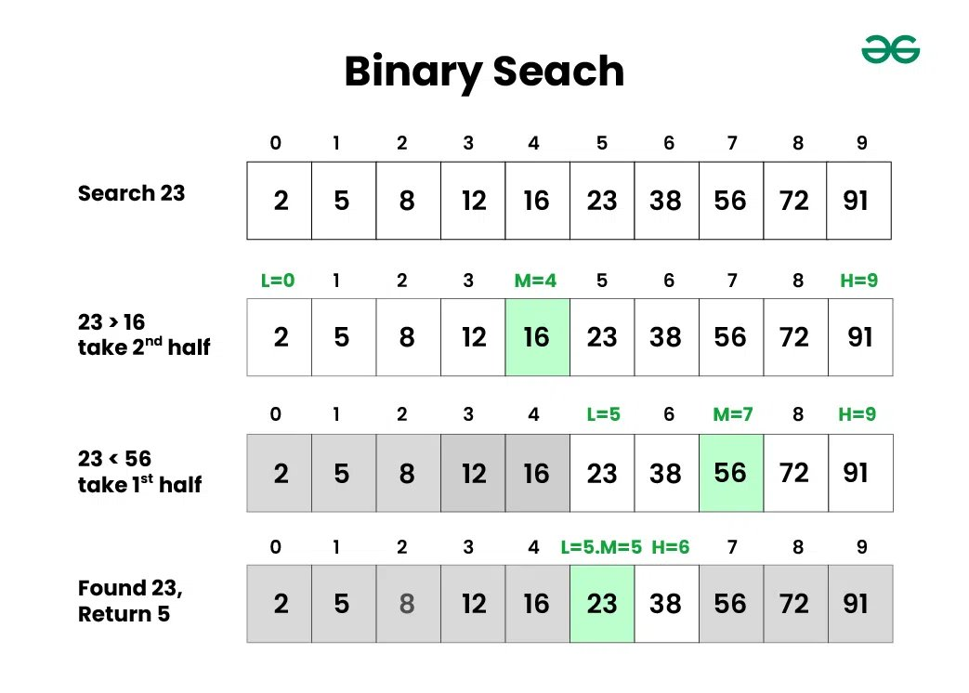
Binary Search

Slide 14
Binary Search
def binary_search(arr, low, high, x):
"""assumes array is already sorted"""
if high >= low:
mid = (high + low) // 2
if arr[mid] == x:
return mid
elif arr[mid] > x:
return binary_search(arr, low, mid - 1, x)
else:
return binary_search(arr, mid + 1, high, x)
else:
return -1

Slide 15
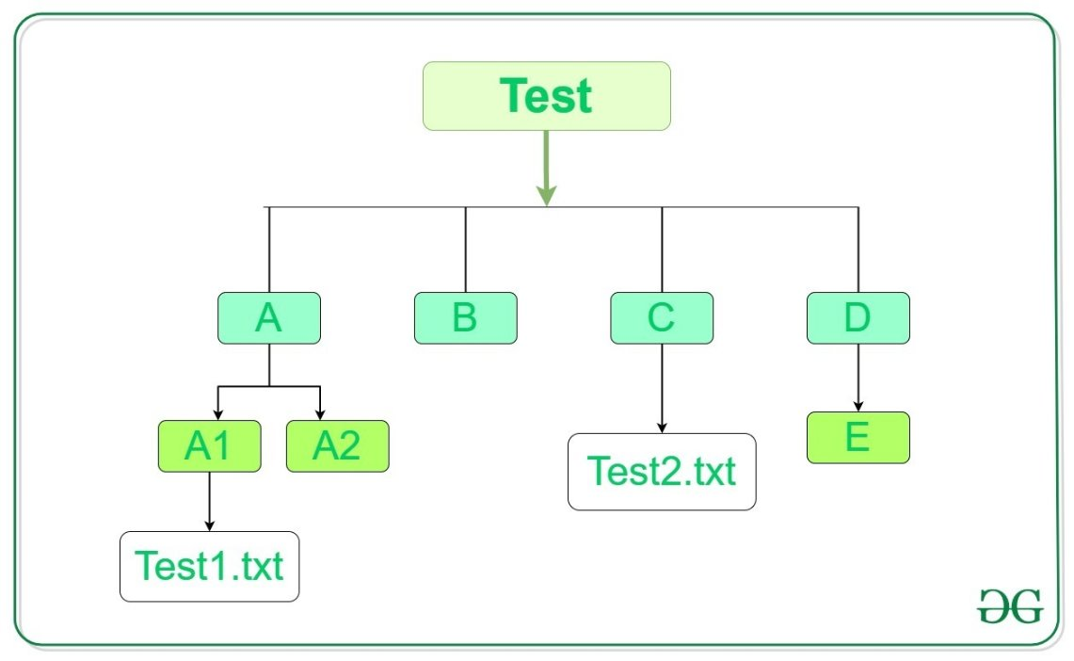
Directory Traversal

Slide 16
Directory Traversal
import os
def list_dir_recursive(directory):
for entry in os.listdir(directory):
full_path = os.path.join(directory, entry)
if os.path.isdir(full_path):
list_dir_recursive(full_path)
else:
print(full_path)

Slide 17

Other Thoughts / On Your Own
Order of Execution
(depth vs breadth)
Recursive vs Iterative
Tail-call optimization

Slide 18
Questions?

